Slide 1
DSA 8301 – Stat Inference in Big Data
Lecture 5
Comparing Estimators

Slide 2
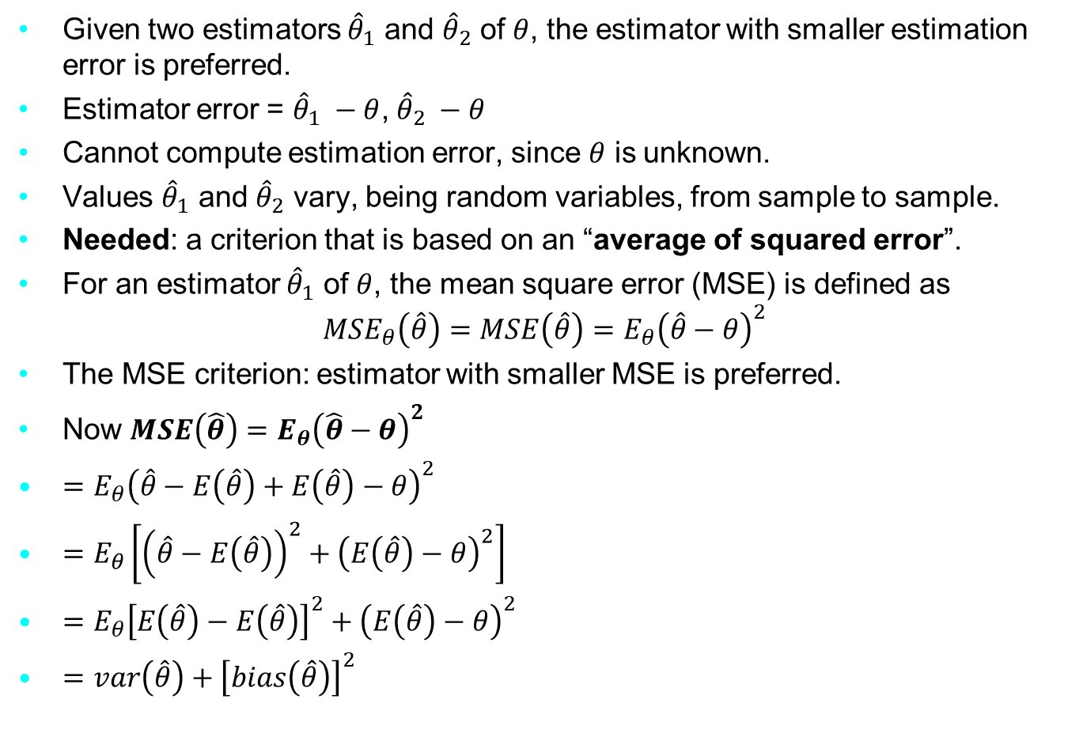
The MSE criterion
Given two estimators ${\hat{θ}}_{1}$ and ${\hat{θ}}_{2}$ of $θ$, the estimator with smaller estimation error is preferred.
Estimator error = ${\hat{θ}}_{1} −θ$, ${\hat{θ}}_{2} −θ$
Cannot compute estimation error, since $θ$ is unknown.
Values ${\hat{θ}}_{1}$ and ${\hat{θ}}_{2}$ vary, being random variables, from sample to sample.
Needed: a criterion that is based on an “average of squared error”.
For an estimator ${\hat{θ}}_{1}$ of $θ$, the mean square error (MSE) is defined as
$${MSE}_{θ}\left(\hat{θ}\right)=MSE\left(\hat{θ}\right)=E_{θ}{\left(\hat{θ}−θ\right)}^{2}$$
The MSE criterion: estimator with smaller MSE is preferred.
Now $MSE\left(\hat{θ}\right)=E_{θ}{\left(\hat{θ}−θ\right)}^{2}$
$=E_{θ}{\left(\hat{θ}−E\left(\hat{θ}\right)+E\left(\hat{θ}\right)−θ\right)}^{2}$
$=E_{θ}\left[{\left(\hat{θ}−E\left(\hat{θ}\right)\right)}^{2}+{\left(E\left(\hat{θ}\right)−θ\right)}^{2}\right]$
$=E_{θ}{\left[E\left(\hat{θ}\right)−E\left(\hat{θ}\right)\right]}^{2}+{\left(E\left(\hat{θ}\right)−θ\right)}^{2}$
$=var\left(\hat{θ}\right)+{\left[bias\left(\hat{θ}\right)\right]}^{2}$
Notes:
The genetic material that carries the instructions that allow cells to make proteins
Composed of a sugar phosphate backbone from which four nitrogenous bases- adenine (A), guanine (G), cytosine (C), and thymine (T) protrude
Arranged in a double helix- two strands are held together by specific pairings between bases A – T pair and G – C pair

Slide 3





The MSE criterion
For $\hat{θ}$ unbiased, $MSE\left(\hat{θ}\right)=var\left(\hat{θ}\right)=σ_{θ}^{2}$
Thus, among two unbiased estimators, the MSE criterion select the one with the smaller standard error $=\sqrt{var\left(\hat{θ}\right)}$
PDF of ${\hat{θ}}_{1}$
PDF of ${\hat{θ}}_{2}$
$$\hat{θ}$$
$$θ$$
Notes:
The genetic material that carries the instructions that allow cells to make proteins
Composed of a sugar phosphate backbone from which four nitrogenous bases- adenine (A), guanine (G), cytosine (C), and thymine (T) protrude
Arranged in a double helix- two strands are held together by specific pairings between bases A – T pair and G – C pair

Slide 4
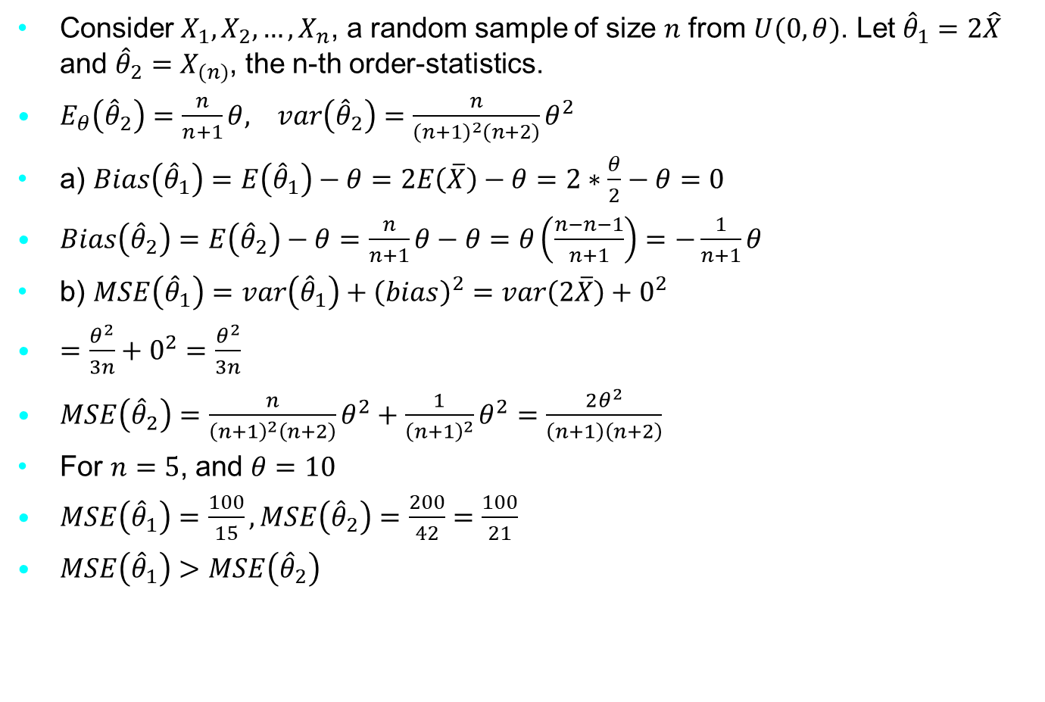
Example 1
Consider $X_{1}, X_{2}, …, X_{n}$, a random sample of size $n$ from $U(0, θ)$. Let ${\hat{θ}}_{1}=2\hat{X}$ and ${\hat{θ}}_{2}=X_{(n)}$, the n-th order-statistics.
$E_{θ}\left({\hat{θ}}_{2}\right)=\frac{n}{n+1}θ, var\left({\hat{θ}}_{2}\right)=\frac{n}{{\left(n+1\right)}^{2}\left(n+2\right)}θ^{2}$
a) $Bias\left({\hat{θ}}_{1}\right)=E\left({\hat{θ}}_{1}\right)−θ=2E\left(\overline{X}\right)−θ=2∗\frac{θ}{2}−θ=0$
$Bias\left({\hat{θ}}_{2}\right)=E\left({\hat{θ}}_{2}\right)−θ=\frac{n}{n+1}θ−θ=θ\left(\frac{n−n−1}{n+1}\right)=−\frac{1}{n+1}θ$
b) $MSE\left({\hat{θ}}_{1}\right)=var\left({\hat{θ}}_{1}\right)+{\left(bias\right)}^{2}=var\left(2\overline{X}\right)+0^{2}$
$=\frac{θ^{2}}{3n}+0^{2}=\frac{θ^{2}}{3n}$
$MSE\left({\hat{θ}}_{2}\right)=\frac{n}{{\left(n+1\right)}^{2}\left(n+2\right)}θ^{2}+\frac{1}{{\left(n+1\right)}^{2}}θ^{2}=\frac{2θ^{2}}{\left(n+1\right)\left(n+2\right)}$
For $n=5$, and $θ=10$
$MSE\left({\hat{θ}}_{1}\right)=\frac{100}{15},MSE\left({\hat{θ}}_{2}\right)=\frac{200}{42}=\frac{100}{21}$
$MSE\left({\hat{θ}}_{1}\right)>MSE\left({\hat{θ}}_{2}\right)$
Notes:
The genetic material that carries the instructions that allow cells to make proteins
Composed of a sugar phosphate backbone from which four nitrogenous bases- adenine (A), guanine (G), cytosine (C), and thymine (T) protrude
Arranged in a double helix- two strands are held together by specific pairings between bases A – T pair and G – C pair

Slide 5
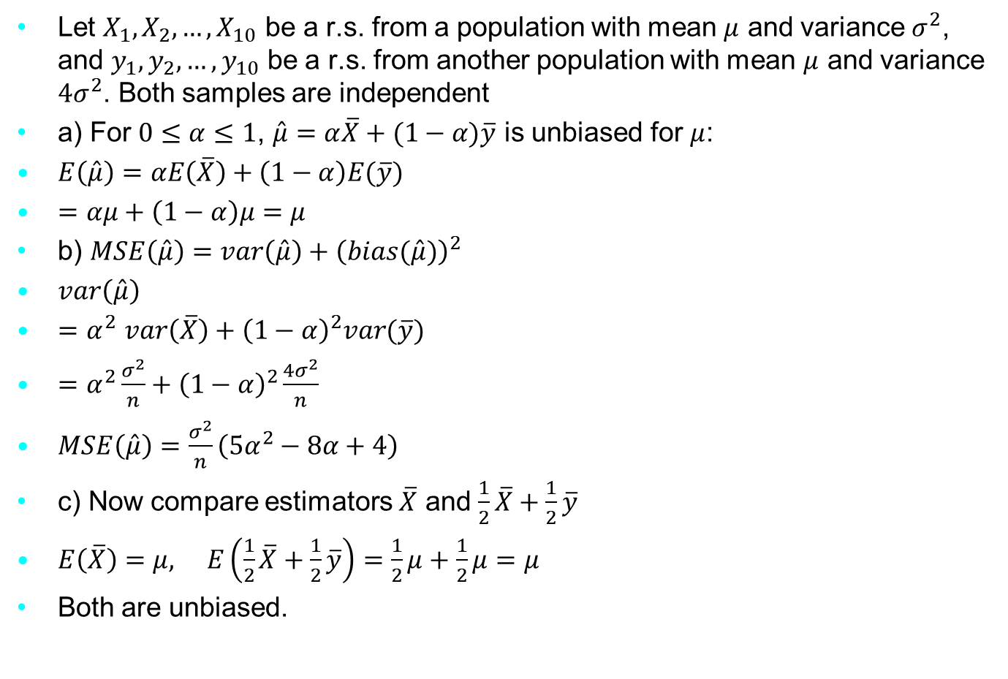
Example 2
Let $X_{1}, X_{2}, …, X_{10}$ be a r.s. from a population with mean $μ$ and variance $σ^{2}$, and $y_{1}, y_{2}, …, y_{10}$ be a r.s. from another population with mean $μ$ and variance ${4σ}^{2}$. Both samples are independent
a) For $0≤α≤1$, $\hat{μ}=α\overline{X}+(1−α)\overline{y}$ is unbiased for $μ$:
$E\left(\hat{μ}\right)=αE\left(\overline{X}\right)+\left(1−α\right)E(\overline{y})$
$=αμ+\left(1−α\right)μ=μ$
b) $MSE\left(\hat{μ}\right)=var\left(\hat{μ}\right)+{\left(bias(\hat{μ})\right)}^{2}$
$var\left(\hat{μ}\right)$
${=α}^{2}var\left(\overline{X}\right)+{\left(1−α\right)}^{2}var(\overline{y})$
$=α^{2}\frac{σ^{2}}{n}+{\left(1−α\right)}^{2}\frac{4σ^{2}}{n}$
$MSE\left(\hat{μ}\right)=\frac{σ^{2}}{n}\left(5α^{2}−8α+4\right)$
c) Now compare estimators $\overline{X}$ and $\frac{1}{2}\overline{X}+\frac{1}{2}\overline{y}$
$E\left(\overline{X}\right)=μ, E\left(\frac{1}{2}\overline{X}+\frac{1}{2}\overline{y}\right)=\frac{1}{2}μ+\frac{1}{2}μ=μ$
Both are unbiased.
Notes:
The genetic material that carries the instructions that allow cells to make proteins
Composed of a sugar phosphate backbone from which four nitrogenous bases- adenine (A), guanine (G), cytosine (C), and thymine (T) protrude
Arranged in a double helix- two strands are held together by specific pairings between bases A – T pair and G – C pair

Slide 6

Example 2
$MSE\left(\overline{X}\right)=var\left(\overline{X}\right)=\frac{σ^{2}}{n}$
$MSE\left(\frac{1}{2}\overline{X}+\frac{1}{2}\overline{y}\right)=var\left(\frac{1}{2}\overline{X}+\frac{1}{2}\overline{y}\right)=\frac{1}{4}\left(var\left(\overline{X}\right)+var\left(\overline{y}\right)\right)$
$\frac{1}{4}\left(\frac{σ^{2}}{n}+\frac{4σ^{2}}{n}\right)$
$\frac{5}{4n}σ^{2}=\frac{1.25σ^{2}}{n}$
$∴MSE\left(\overline{X}\right)<MSE\left(\frac{1}{2}\overline{X}+\frac{1}{2}\overline{y}\right)$
$\overline{X}$ is preferable to $\frac{1}{2}\overline{X}+\frac{1}{2}\overline{y}$
Notes:
The genetic material that carries the instructions that allow cells to make proteins
Composed of a sugar phosphate backbone from which four nitrogenous bases- adenine (A), guanine (G), cytosine (C), and thymine (T) protrude
Arranged in a double helix- two strands are held together by specific pairings between bases A – T pair and G – C pair

Slide 7
Exercise
Facilities A and B account for 60% and 40%, respectively, of the production of a certain electronic component. The two components from the two facilities are shipped to a packaging location where they are mixed and packaged. A sample of size 100 will be used to estimate the expected life time in the combined population. Use the MSE criterion to decide which of the following two sampling schemes (simple random versus stratified sampling) should be adapted, i.e.
a) simple random sampling at the packaging location, and
b) stratified random sampling based on a simple random sample of size 60 from facility A and a simple random sample of size 40 from facility B.
Notes:
The genetic material that carries the instructions that allow cells to make proteins
Composed of a sugar phosphate backbone from which four nitrogenous bases- adenine (A), guanine (G), cytosine (C), and thymine (T) protrude
Arranged in a double helix- two strands are held together by specific pairings between bases A – T pair and G – C pair

